Slide 1
SDN and Wireless Network Security
Saim Ghafoor
Lecture 2-1
SDN Architecture and planes

Slide 2
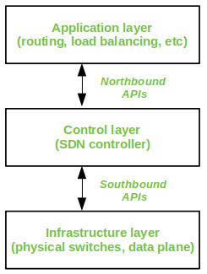
SDN Architecture
A typical SDN architecture consists of three layers.
Application layer:
It contains the typical network applications like intrusion detection, firewall, and load balancing
Control layer:
It consists of the SDN controller, which acts as the brain of the network. It also allows hardware abstraction to the applications written on top of it.
Infrastructure layer:
This consists of physical switches which form the data plane and carry out the actual movement of data packets.
The layers communicate via a set of interfaces called the northbound APIs(between application and control layer) and southbound APIs(between control and infrastructure layer).

Slide 3
Advantages/Disadvantages of SDN
Advantages of SDN:
Network is programmable hence can easily be modified via the controller rather than individual switches.
Switch hardware becomes cheaper since each switch only needs a data plane.
Hardware is abstracted, hence applications can be written on top of controller independent of switch vendor.
Provides better security since the controller can monitor traffic and deploy security policies. For example, if the controller detects suspicious activity in network traffic, it can reroute or drop the packets.
Disadvantages of SDN: The central dependency of the network means single point of failure, i.e. if the controller gets corrupted, the entire network will be affected.

Slide 4
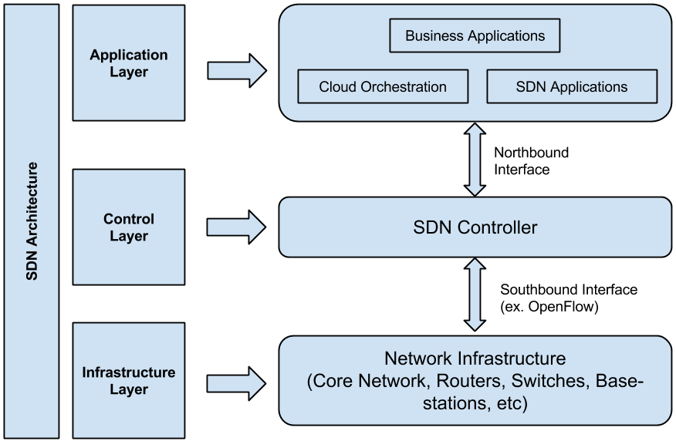
Planes
In order to understand software defined networks, we need to understand the various planes involved in networking.
Data plane: All the activities involving as well as resulting from data packets sent by the end user belong to this plane. This includes:
Forwarding of packets
Segmentation and reassembly of data
Replication of packets for multicasting
Control plane: All activities necessary to perform data plane activities but do not involve end user data packets belong to this plane. In other words, this is the brain of the network. The activities of the control plane include:
Making routing tables
Setting packet handling policies

Slide 5
In a traditional network, each switch has its own data plane as well as control plane. The control plane of various switches exchange topology information and hence construct a forwarding table which decides where an incoming data packet has to be forwarded via the data plane.
Software defined networking (SDN) is an approach via which we take the control plane away from the switch and assign it to a centralised unit called the SDN controller. Hence, a network administrator can shape traffic via a centralised console without having to touch the individual switches.

Slide 6
How switch decides when packet enters a switch?
The data plane still resides in the switch and when a packet enters a switch, its forwarding activity is decided based on the entries of flow tables, which are pre-assigned by the controller. A flow table consists of match fields (like input port number and packet header) and instructions. The packet is first matched against the match fields of the flow table entries.
Then the instructions of the corresponding flow entry are executed. The instructions can be
forwarding the packet via one or multiple ports,
dropping the packet or adding headers to the packet.
If a packet doesn’t find a corresponding match in the flow table, the switch queries the controller which sends a new flow entry to the switch. The switch forwards or drops the packet based on this flow entry.

Slide 7
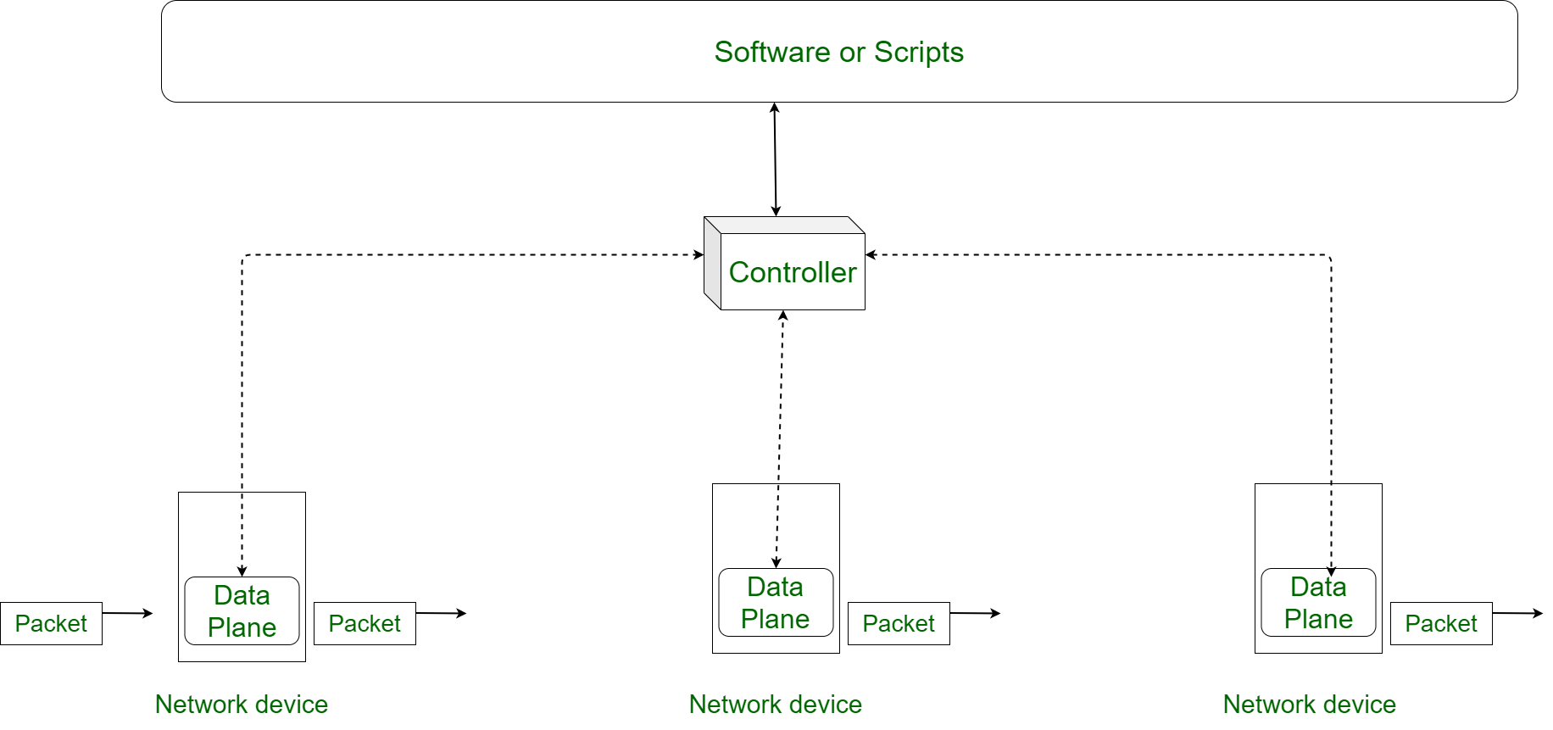
SDN Controller
In Centralized control plane system, there is a device which contains control plane of all devices. This device control the activities of data plane of all networking devices simultaneously. This device is called Controller or SDN controller.

Slide 8
Southbound interface
In SDN, all networking devices must be connected to controller so that it can regulate data planes of all devices. When drawing architecture of network, usually the network architect places networking devices below controller. Now according to map conventions, interface between controller and networking devices lies to south of controller. Hence, these interfaces are called Southbound Interface.
Southbound interface is an interface between a program on controller and a program on networking device. Note that these interfaces we are discussing are software interface not physical one.

Slide 9
Northbound Interface
Controller need to know many information regarding network so that it can control data plane of networking devices. Provided by Network Programmer (NP).
NP provide essential information to controller through various software or script about what functions it has to do. These softwares/scripts are placed above controller in network architecture.
This placement of software/script makes interfaces between controller and software in north direction, according to map conventions. Hence, Interfaces between controller and softwares are called Northbound Interface. These interfaces enable programmability of network.
All interfaces we discussed above are program based interfaces. These interfaces in a broader sense are called Application Program Interface (API).
An API is an interface through which two program can exchange data between them.

Slide 10
What are the control and data planes
Control plane: Logic for controlling forwarding behaviour
Examples routing protocols, network middlebox configuration
Data plane: Forwarding traffic according to control plane logic
Examples: IP forwarding, layer 2 switching

Slide 11
Why separate the control and data planes?
Independent evolution and development
The software control of the network can evolve independently of the hardware
Control from high level software program
Control behavior using higher order programs
Debug and check behavior more easily

Slide 12
Opportunities: Where separation Helps
Data centers: VM migration, Layer 2 routing
Routing: More control over decision logic
Enterprise networks: Security applications
Research networks: Coexistence with production

Slide 13
Other opportunities separating the control and data plane offers
Dynamic access control
Seamless mobility/migration
Server load balancing
Network virtualization
Using multiple wireless access points
Energy efficient networking
Adaptive traffic monitoring
Denial of service attack detection

Slide 14
Challenges of separating Control and Data plane
Scalability: control elements responsible for many forwarding elements (often thousands +)
Reliability/Security: What happens when a controller fails or is compromised

Slide 15
Evolution of network programming
Evolution of SDN
RCP
4D architecture
OpenFlow (SDN)

Slide 16
Routing Control Platform (RCP)
The Routing Control Platform (RCP) is a centralized forwarding solution enabling the collection of a network topology map, running an algorithm, and selecting the preferred BGP route for each router in an Autonomous System (AS).
RCP is the earliest example of control and data plane separation
Designed for ISPs to control AS and using mainly BGP
A software-based solutions that give network administrators greater control over the routing decisions within their networks.
A centralized interface for managing and distributing routing information

Slide 17
Benefits of RCP
Enhanced Network Performance
Improved Network Resilience
Increased Security
Scalability and flexibility

Slide 18
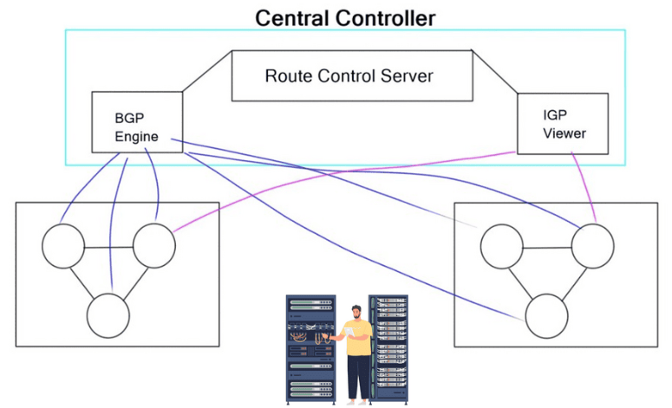
The RCP must have complete visibility. Otherwise, it could assign routes that create black holes, forwarding loops, or other issues preventing packets from reaching their destinations.
A potential issue with route reflection is that AS exit best path selection (hot potato routing) is performed by route reflectors from their IGP reference point, which in turn gets propagated to all RR clients scattered throughout the network. As a result, the best path selected may not be optimal for many RR clients as it depends on where the RR client is logically placed in the network.
Limited to BGP

Slide 19
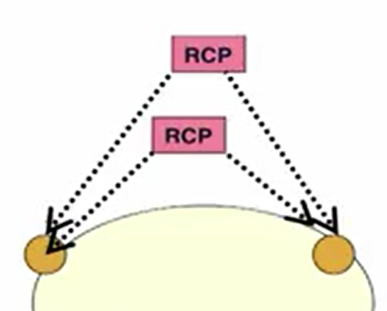
Scalability: RCP
Problem: Must store routes and compute routing decisions for every routers
Potentially thousands of router
Eliminate redundancy
Store a single copy of each route
Avoid redundant computation
Accelerate lookups
Maintain indexes to identify affected routers
Only perform BGP routing
Reliability
Replicate RCPs
Run multiple identical servers
Run independent replicas
Each replica has its own feed of routes
Each replica receives the same inputes and runs the same routing algorithm
No need for a consistency protocol if both replicas always see the same information
Route assignment must be consistent
Even in presence of failures and partitions
Flooding based IGP means each replica knows which partitions it connects to

Slide 20
4D network architecture
The 4D Network Architecture
Motivation
Definitions
How 4D Terminology relates to SDN Today?

Slide 21
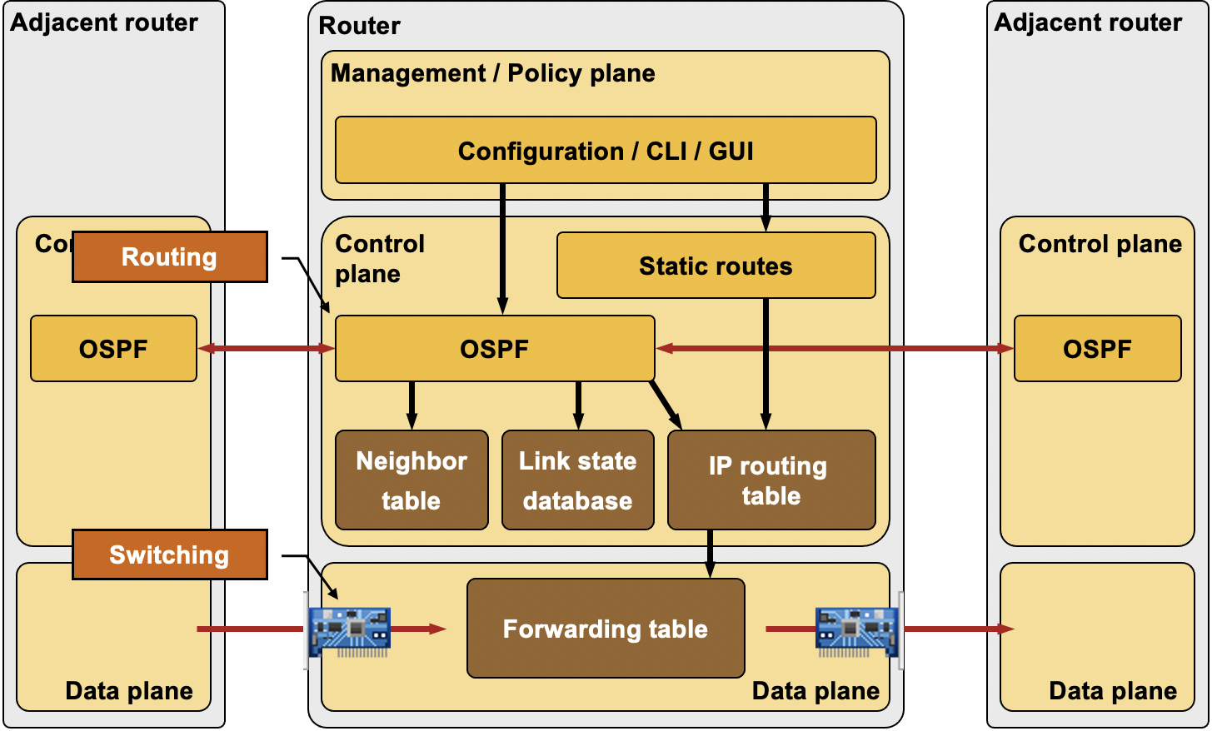
Conventional IP Routers
Management Plane
Construct network wide view
Configure the routers
Control Plane
Track topology changes
Compute routes and install forwarding tables
Data Plane
Forwards, filter, buffer, mark and rate-limit Pkts
Collect traffic statistics

Slide 22
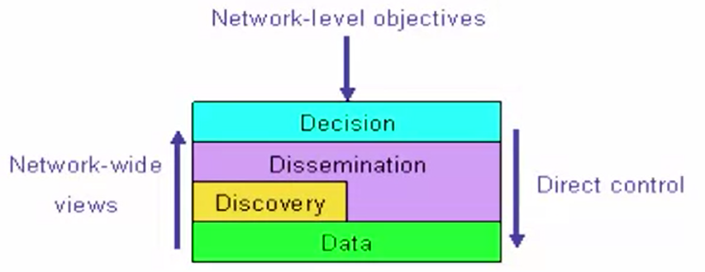
The 4D Planes
Decision: all management and control
Functions that operate on view of entire network and network objectives
Path selection and traffic engineering
Reachability control and VPNs
Dissemination: Communication to/from routers
Functions that support creation of network wide view
Topology discovery
Report measurements, status
Discovery: topology and traffic monitoring
Data: traffic handling

Slide 23
Three Goals of 4D architecture
Network level objectives
Configure the network, not the routers
Minimise the maximum link utilization
Ensuring the connectivity under all layer 2 failures
Network wide views
Complete visibility to drive decision-making
Traffic matrix, network topology, equipment
Direct control
Direct, sole control over data plane configuration
Packet forwarding, filtering, marking, buffering

Slide 24
Goal of 4D is to remove/minimise the conventional routing plane
Faster innovation
Remove dependence on vendors
Simpler management systems
No need to invert control plane operations
Easier interoperability between vendors
Simpler, cheaper routers
Little or no software on the routers
Removing the control plane from Routers
Control software can run elsewhere
State and computation is reasonable
System overhead can be amortised
Easier access to other information
Some control can move to end hosts

Slide 25
SDN still have a control plane, but it's not what 4D called a control plane
4D control plane is a distributed routing protocols
What we refer to as control plane todays is the Decision Plane in 4D
The dissemination plane lives on, but we call it a control channel
In RCP dissemination plane is BGP
In OpenFlow, its ‘secchan’

